Slide 1
Memoization in different programming languages
By: Kate Arvay, Tibor Blascsok, Antoine Geiger

Slide 2
Table of contents
Memoization
Python
PhP - Laravel
Java
Conclusion
References

Slide 3
1. Memoization
What is memoization?
functional programming optimisation technique used to accelerate computer programs
“it consists of storing in cache the output of a function, and making the function check if each required computation is in the cache before computing it”(3)
Why is it useful?
speeds up application performance by cutting costs of heavy function calls
What factors can influence efficiency?
A real-world analogy

Slide 4

2. Python
Data handling
Practical and scalable usage
Speed comparison
Result

Slide 5
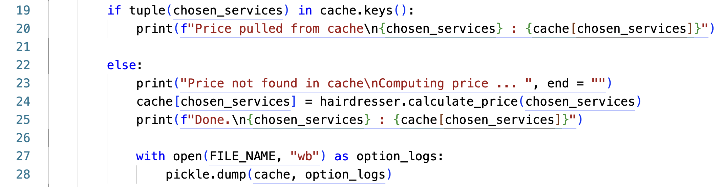
Data handling

Slide 6
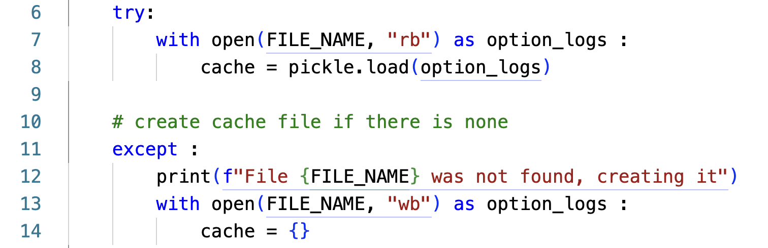
Practical and scalable usage

Slide 7
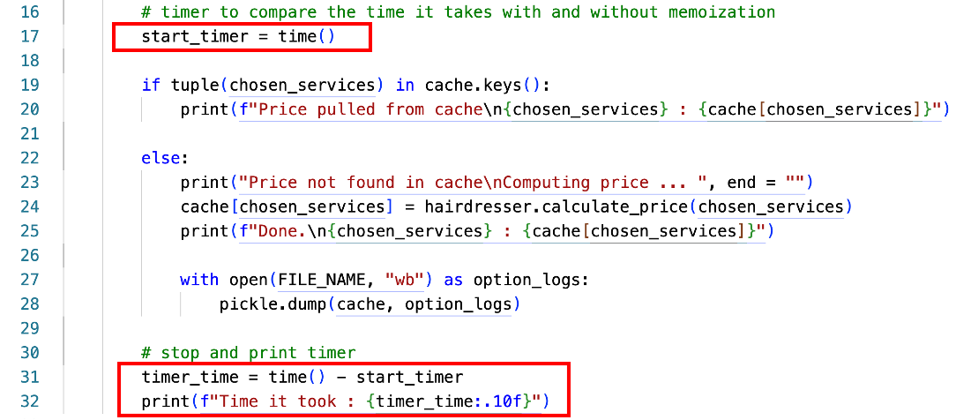
Speed Comparision

Slide 8
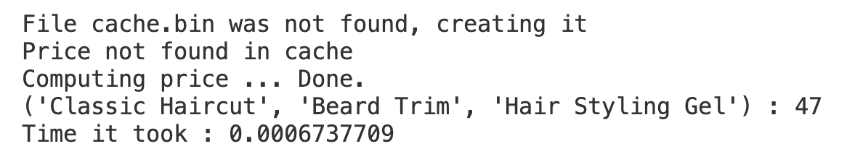
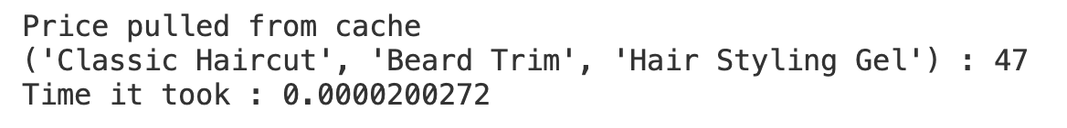
Result

Slide 9

3. PhP - Laravel
What is Laravel?
Different caching methods
Code

Slide 10
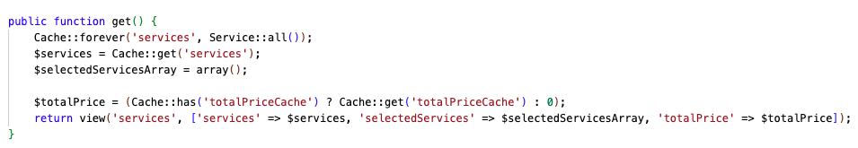
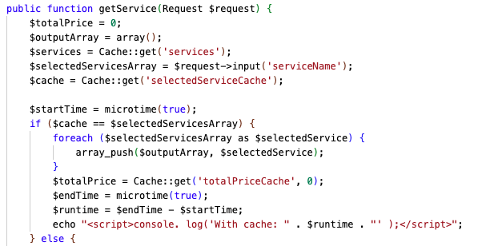

Slide 11
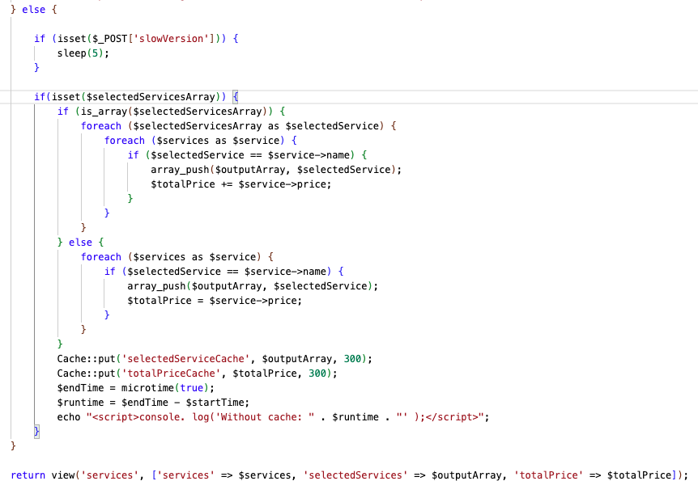

Slide 12

4. Java
Implementation example
Use Case algorithm
Test Case
Execution time comparison

Slide 13
Implementation example
calculating and displaying the total duration and cost of various service combinations
instead of computing the totals for same service combination, the result is retrieved from cache
caching done by using HashMap
Key: serviceCombination (hashed and stringified key (ignore order))
Value: computed total duration and total price

Slide 14
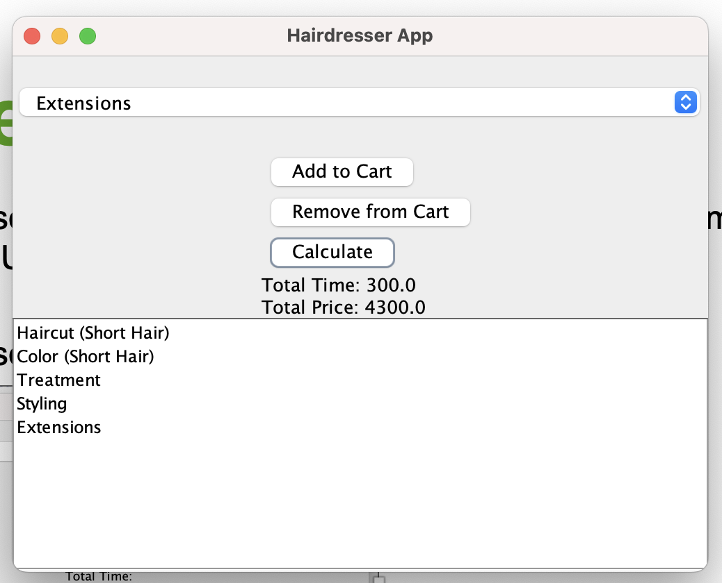
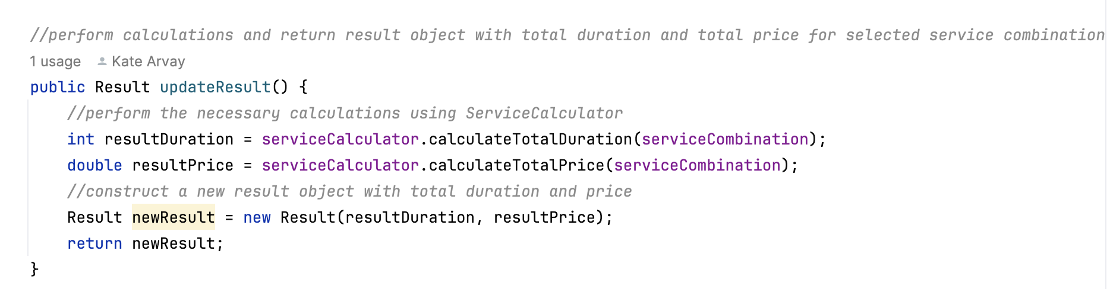
Use Case algorithm
1. user selects a service to be added to/removed from cart (service combination list and UI updated dynamically on button click)
2. user clicks “Calculate” which triggers calculation algorithm

Slide 15
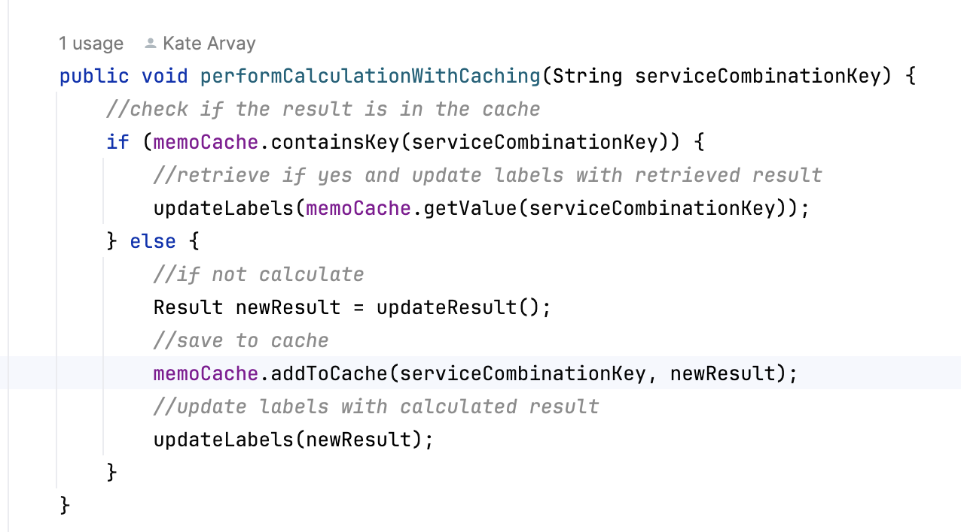
Use Case algorithm
3. checks if the value is in cache by passing key as an argument
a) key found in cash – retrieve value and update UI
b) key not found – calculate and put the service combination with the computed value in the cache, update UI

Slide 16
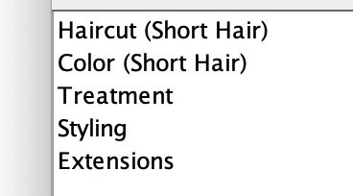
Test Case
1. Select and add following services to cart:
2. Click „Calculate“ (selected combination not in cache, will be saved to cash)
3. Observe the time log on the console (without caching)
4. Remove “Extensions“ and add them again resulting in the same service combination that is already in the cache
5. Click „Calculate” (results in cache hit, item will be retrieved from cache)
6. Observe the time log on the console
7. Compare the execution time
Expected Result: execution time for cache hit shorter

Slide 17
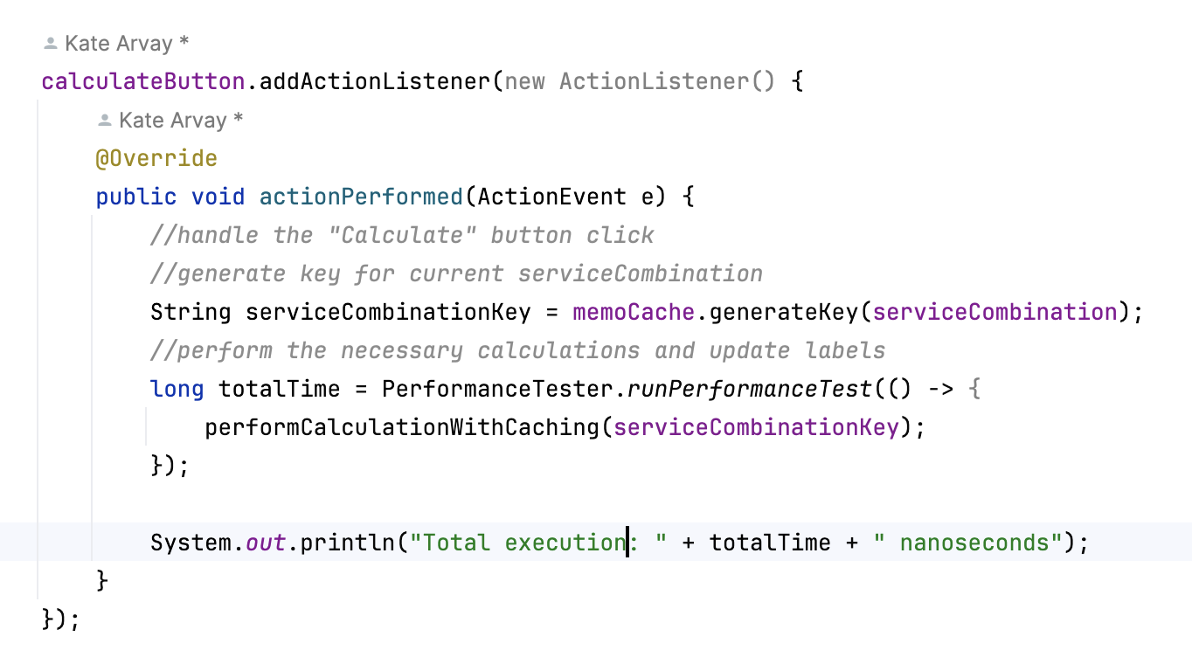
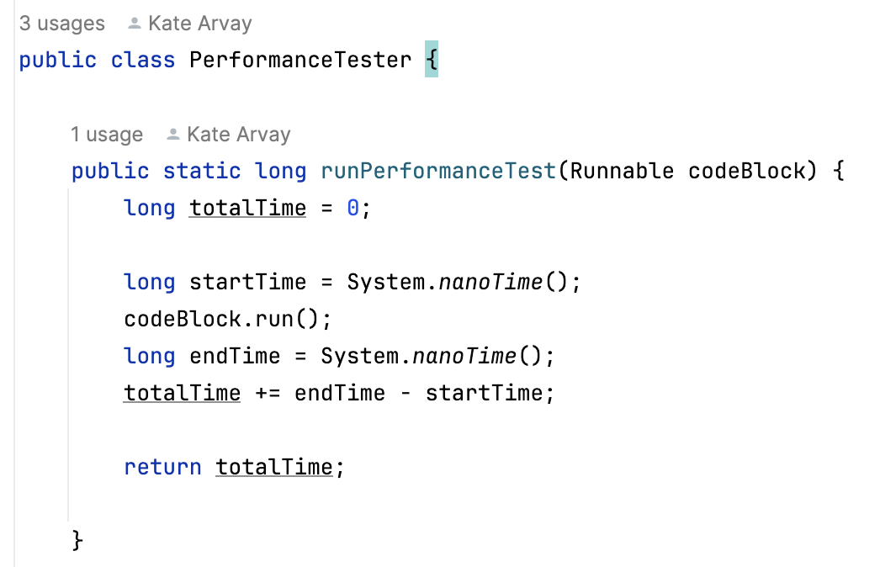
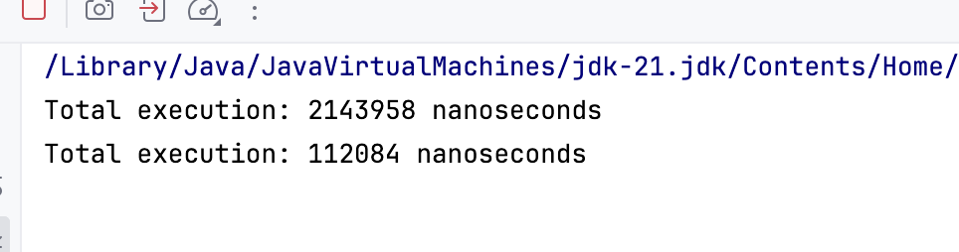
Execution Time Comparison
without cache
cache hit

Slide 18
5. Conclusion
”Memoization is a simple but powerful trick that can help speed up our code, especially when dealing with repetitive and heavy computing functions”(3)or or functions that are called frequently with the same input parameters(4)
“It is important to consider the trade-off between memory usage and computational savings when deciding when to apply memoization” (4) in real world scenarios.

Slide 19
6. References
https://www.syncfusion.com/blogs/post/what-is-memoization-in-react.aspx
https://dzone.com/articles/java-8-automatic-memoization
https://www.freecodecamp.org/news/memoization-in-javascript-and-react/
https://rangle.io/blog/react-memoization

